Slide 1
review of Encryption basics

Slide 2
Encryption
Goal: protect data confidentiality by TRANSFORMING data into something incomprehensible
Transformation must be reversible!
Symmetric encryption: same key for encrypt and decrypt
Enc/Dec algorithms should be PUBLICLY known; secret should only be in the key!
Plaintext P
Ciphertext C
Plaintext P
Cipher (algorithm)
C = ENC(K,P)
Cipher (algorithm)
P = DEC(K,C)
(Symmetric) key K
(Symmetric) key K

Slide 3
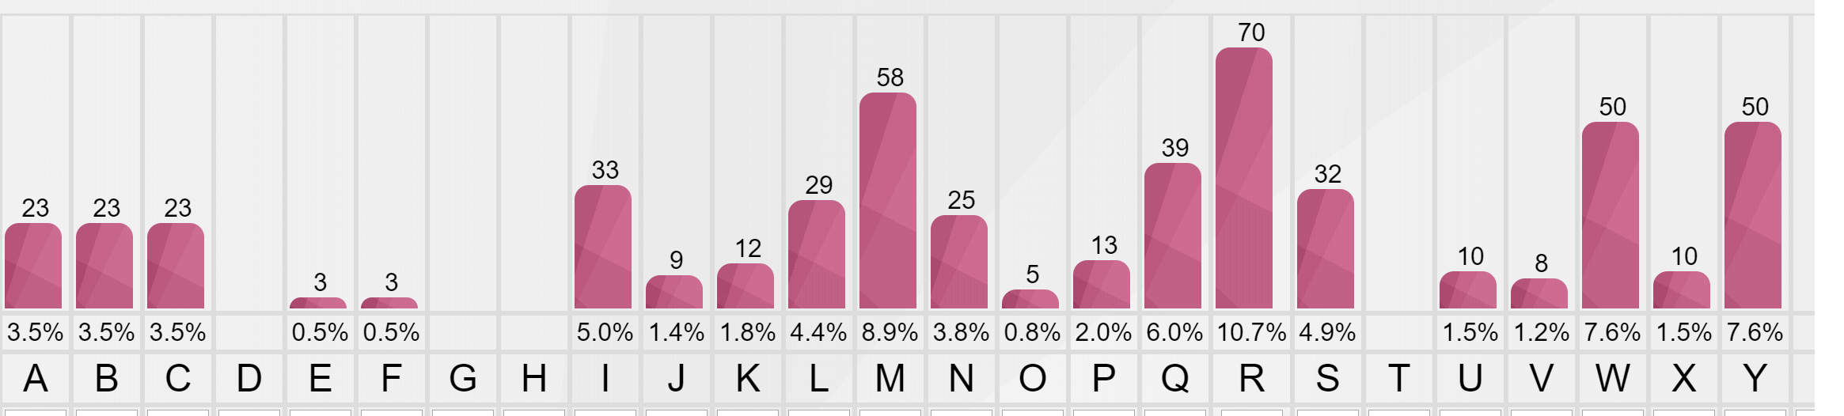
Substitution cipher
YCNWR CANWKR WL VCMY UQUMLIQ ICIIR RIIWYYRIR BRYYM URLW BMYYR URBSM. W LMSW M JWQKRLWYW NRPMYYW, APRSIWIW AQPSR YR ESQLIM, NQL CLR FWRLNR M AQIIWYM BWSWXXRICSR, AW SRKKQYJMKRL, BWMISQ WY NRPQ, WL NMSNOW UQYIMPYWNW
BW ISMNNM, ISRPRAARIM BR YCLJOW APWYYW B'RSJMLIQ, VCRAW R JCWAR BM' SRJJW B'CL'RCSMQYR. QYISM R VCMAIQ, NO'MSR Y'QSLRUMLIQ PRSIWNQYRSM BMY JWQSLQ BMYYM LQXXM, YCNWR RKMKR VCMYYQ VCQIWBWRLQ B'CLR UQBMAIR FMYYMXXR, SWYMKRIR RYYQSR M RNNSMANWCIR BRYYM KRSWM REEMXWQLW NOM YM AW BWPWLJMKRL ACY KWAQ: VCMY PYRNWBQ RNNQSRUMLIQ NOM AW UQAISR BW VCRLB'WL VCRLBQ ACY KQYIQ BMYYM APQAM, M, AMLXR ANQUPQS YR FMYYMXXR, YM BR' CL NRSRIIMSM PRSIWNQYRSM...
Repeating patterns? ☺
Frequency analysis, e.g. https://www.101computing.net/frequency-analysis/

Slide 4
Substitution cipher
YCNWR CANWKR WL VCMY UQUMLIQ ICIIR RIIWYYRIR BRYYM URLW BMYYR URBSM. W LMSW M JWQKRLWYW NRPMYYW, APRSIWIW AQPSR YR ESQLIM, NQL CLR FWRLNR M AQIIWYM BWSWXXRICSR, AW SRKKQYJMKRL, BWMISQ WY NRPQ, WL NMSNOW UQYIMPYWNW
BW ISMNNM, ISRPRAARIM BR YCLJOW APWYYW B'RSJMLIQ, VCRAW R JCWAR BM' SRJJW B'CL'RCSMQYR. QYISM R VCMAIQ, NO'MSR Y'QSLRUMLIQ PRSIWNQYRSM BMY JWQSLQ BMYYM LQXXM, YCNWR RKMKR VCMYYQ VCQIWBWRLQ B'CLR UQBMAIR FMYYMXXR, SWYMKRIR RYYQSR M RNNSMANWCIR BRYYM KRSWM REEMXWQLW NOM YM AW BWPWLJMKRL ACY KWAQ: VCMY PYRNWBQ RNNQSRUMLIQ NOM AW UQAISR BW VCRLB'WL VCRLBQ ACY KQYIQ BMYYM APQAM, M, AMLXR ANQUPQS YR FMYYMXXR, YM BR' CL NRSRIIMSM PRSIWNQYRSM...
Frequency of Italian letters
Frequency analysis, e.g. https://www.101computing.net/frequency-analysis/

Slide 5
Substitution cipher
YCNWR CANWKR WL VCMY UQUMLIQ ICIIR RIIWYYRIR BRYYM URLW BMYYR URBSM. W LMSW M JWQKRLWYW NRPMYYW, APRSIWIW AQPSR YR ESQLIM, NQL CLR FWRLNR M AQIIWYM BWSWXXRICSR, AW SRKKQYJMKRL, BWMISQ WY NRPQ, WL NMSNOW UQYIMPYWNW
BW ISMNNM, ISRPRAARIM BR YCLJOW APWYYW B'RSJMLIQ, VCRAW R JCWAR BM' SRJJW B'CL'RCSMQYR. QYISM R VCMAIQ, NO'MSR Y'QSLRUMLIQ PRSIWNQYRSM BMY JWQSLQ BMYYM LQXXM, YCNWR RKMKR VCMYYQ VCQIWBWRLQ B'CLR UQBMAIR FMYYMXXR, SWYMKRIR RYYQSR M RNNSMANWCIR BRYYM KRSWM REEMXWQLW NOM YM AW BWPWLJMKRL ACY KWAQ: VCMY PYRNWBQ RNNQSRUMLIQ NOM AW UQAISR BW VCRLB'WL VCRLBQ ACY KQYIQ BMYYM APQAM, M, AMLXR ANQUPQS YR FMYYMXXR, YM BR' CL NRSRIIMSM PRSIWNQYRSM...
Frequency of Italian letters
Y = High frequency consonant (L, N, R, T)
R,M,W, = likely vowel (A, E, I, O) and W→I most likely…
Frequency analysis, e.g. https://www.101computing.net/frequency-analysis/

Slide 6
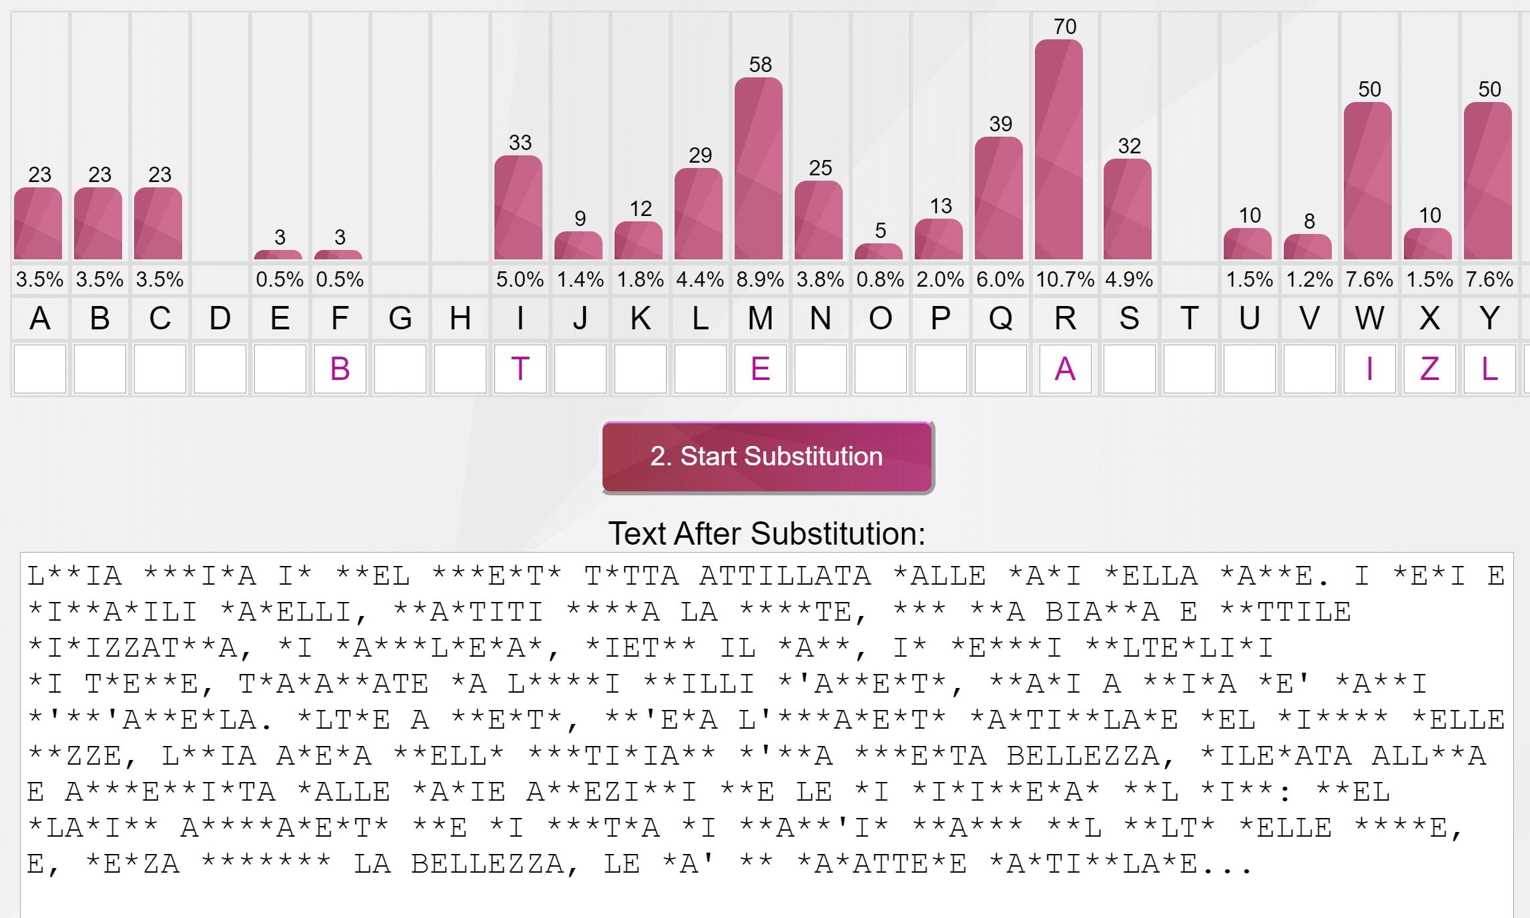
Substitution cipher
And…
→ trials&errors → digram statistics → etc

Slide 7
Substitution cipher solution!
Key: RFNBMEJOWGTYULQPVSAICKDHZX
Plaintext:
Lucia usciva in quel momento tutta attillata dalle mani della madre. I neri e giovanili capelli, spartiti sopra la fronte, con una bianca e sottile dirizzatura, si ravvolgevan, dietro il capo, in cerchi molteplici
di trecce, trapassate da lunghi spilli d'argento, quasi a guisa de' raggi d'un'aureola. Oltre a questo, ch'era l'ornamento particolare del giorno delle nozze, Lucia aveva quello quotidiano d'una modesta bellezza, rilevata allora e accresciuta dalle varie affezioni che le si dipingevan sul viso: quel placido accoramento che si mostra di quand'in quando sul volto delle spose, e, senza scompor la bellezza, le da' un carattere particolare...

Slide 8

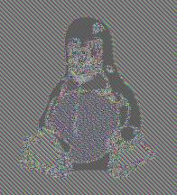
A graphical example of how leaky substitution ciphers may be!
Problem is: same plaintext pixel → same ciphertext pixel!
More later on this (extremely poor!) approach when talking about Electronic Code Books in block ciphers!!

Slide 9
One time pad (Vernam cipher)
10111101…
-----
-----
-----
= 10111101…
⊕
⊕
10001111…
= 00110010…
00110010… =
Key: random bit sequence
as long as the plaintext
Decrypt by bitwise XOR of
ciphertext and key:
ciphertext ⊕ key =
(plaintext ⊕ key) ⊕ key =
plaintext ⊕ (key ⊕ key) =
plaintext
Encrypt by bitwise XOR of
plaintext and key:
ciphertext = plaintext ⊕ key
CT = ENC(K,M) = M ⊕ K
M = DEC(K,CT) = CT ⊕ K
Source: V. Shmatikov

Slide 10
One time pad
Unconditionally secure (perfect secrecy – see Shannon) if…
If as many keys as messages
keys must be as long as plaintext
If keys are random
But…
No integrity
Eve can change message
Insecure if keys are reused
XOR → key cancels, plaintext XOR
Random means… random...
Pseudorandom is NOT random!!

Slide 11
Perfect secrecy (unconditional security)
Information bit XOR random bit = random bit!
XOR with random string «removes» any information on plaintext!
Secret
bit
Random
bit
XOR result
bit
⊕
0
0
0
p/2
Secret bit
Random bit
0
1
1
p/2
Probability:
0=p
1=(1-p)
Probability:
0=1/2
1=1/2
1
0
1
(1-p)/2
1
1
0
(1-p)/2
Probability to guess a plaintext bit after seeing the ciphertext bit is the same as the a-priori guess (i.e. without having seen any ciphertext!)

Slide 12
Vernam cipher: unconditionally secure! Buon only if…
Keys are TRULY random
Opposed to pseudo-random, more later!
Keys are as long as plaintexts
1 GB plaintext → 1GB key… ??!!
Keys must change at every new message
If key reused, trivial Known Plaintext Attack (KPA)
Assume M1 known and see C1 = M1 ⊕ key
Target: decrypt C2 = M2 ⊕ key
Trivial: C2 ⊕ C1 ⊕ M1 = C2 ⊕ (C1 ⊕ M1) = C2 ⊕ key = M2
Conclusion: vernam cipher is NOT REALISTIC!

Slide 13


One time pad = no integrity
PT
1000 1000 1000 1111
⊕
KEY:
0100 1101 0011 0101
Conclusion:
Best possible
Cipher has
zero integrity!!
CT
1100 0101 1011 1010
⊕
Δ
0000 1001 0000 0000
Let’s turn
1000 in
0001
CT’
1100 1100 1011 1010
⊕
KEY:
0100 1101 0011 0101
PT’
1000 0001 1000 1111

Slide 14
Random ≠ Pseudo Random!!
Pseudo Random Number Generator (PRNG): an algorithm!
E.g. RAND() in C
can be good/bad in three complementary ways
Statistical properties of the output
Predictability
Periodicity
(in crypto, ALL must hold! More later)
Truly Random Number Generator (TRNG): randomness «extracted» from a physical phenomenon!
Thermal noise from resistors (used in HW generators)
athmospheric noise (used by services such as random.org)
etc
May «look» the same, but are VERY different!! TRNG is NOT reproducible…

Slide 15
Warm-up example 1 found on a real paper! ☺

Slide 16
Found in a real proposal (RFID mutual authentication - simplified)
Last key K_{i}
Secret S
tag
query
reader
M1 = S ⊕ K_{i}
verify
K_{i+1}=PRNG(K_{i})
S ⊕ K_{i}, K_{i}
K_{i+1}=PRNG(K_{i})
M2 = S ⊕ K_{i+1}
Verify
K_{i+2}=PRNG(K_{i+1})
K_{i+2}=PRNG(K_{i+1})→ store
Security proof: formal analyzer (AVISPA) → OK!

Slide 17
OK?
one time pad with pseudo-random → stream cipher
Seems ok, as the state of the PRNG is unknown
Last key stored
What if:
M1 ⊕ M2 =
= (S ⊕ K_{i})(S ⊕ K_{i+1}) =
= K_{i} ⊕ K_{i+1}
= random, no information, no disclosure
of PNRG state (if yes → game over)
Apparently, still OK…

Slide 18
OK????????
Constant ciphertext
PSEUDO random generator
KNOWN PRNG
Worst: 16 bits!! But worse than this..
Run: for(x_{i}=0; x_{i}<2¹⁶; x_{i}++)
Z_{i} = x_{i} ⊕ PRNG(x_{i})
Until: Z_{i} == M1 ⊕ M2 = K_{i} ⊕ K_{i+1}
Hence set: K_{i} = PRNG(x_{i})
→ Attacker’s PRNG sync-ed!!!

Slide 19
Example
3 bit toy generator
prng[0]= 6;
prng[6]= 7;
prng[7]= 5;
prng[5]= 1;
prng[1]= 3;
prng[3]= 4;
prng[4]= 2;
prng[2]= 0;
tag
query
reader
M1 = 5 = S ⊕ K_{i}
M2 = 2 = S ⊕ K_{i+1}
Attacker computes 5 ⊕ 2 =
= 0101 ⊕ 0010 = 0111 = 7

Slide 20
Example
And computes table:
0 ⊕ prng[0]= 6;
1 ⊕ prng[1]= 2;
2 ⊕ prng[2]= 2;
3 ⊕ prng[3]= 7;
4 ⊕ prng[4]= 6;
5 ⊕ prng[5]= 4;
6 ⊕ prng[6]= 1;
7 ⊕ prng[7]= 2;
tag
query
reader
M1 = 5 = S ⊕ K_{i}
M2 = 2 = S ⊕ K_{i+1}
K_{i} = 3
K_{i+1} = 4
S = 5 ⊕ 3 = 6 or, otherwise, S = 2 ⊕ 4 = 6
GAME OVER!

Slide 21
What if…
computed table:
0 ⊕ prng[0]= 6;
1 ⊕ prng[1]= 2;
2 ⊕ prng[2]= 2;
3 ⊕ prng[3]= 7;
4 ⊕ prng[4]= 6;
5 ⊕ prng[5]= 4;
6 ⊕ prng[6]= 1;
7 ⊕ prng[7]= 2;
tag
query
reader
M1 = 4 = S ⊕ K_{i}
M2 = 6 = S ⊕ K_{i+1}
M1 ⊕ M2 = 4 ⊕ 6 = 2
K_{i} = 1, 2 or 7 (hence K_{i+1} = 3, 0, or 5)
S = 5, 6, 3 instead of random[0,7]!!!
(and will be discovered at next attempt)

Slide 22
review of Encryption basics (continuation): security definitions

Slide 23
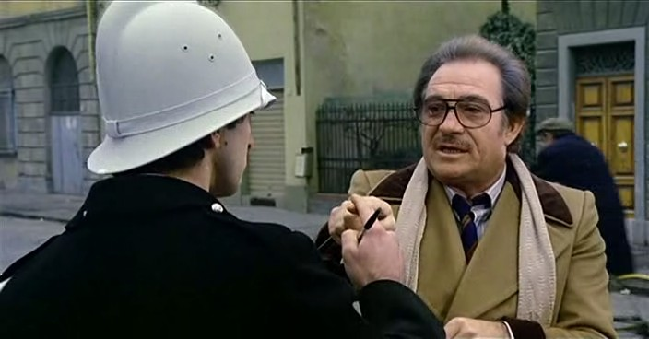


Back to encryption: when a cipher is secure? (we need rigorous security definitions!)
Let’s try with these:
A cipher is secure when it protects confidentiality
A secure cipher properly hides messages
A secure cipher is one that cannot be broken
Nah, Conte Mascetti’s definitions
Or with this
A secure cipher guarantees that every original byte is transformed into a different one
But then, also the most insecure Caesar’s cipher does this!
Or these: a cipher is secure if…
… if nothing can be learned about the internal plaintex
… if the ciphertext is undistinguishable from a random string
Seem better, but still a bit too informal!

Slide 24
Defining security
«Absolute» security hardly makes sense!
you are secure with respect to an adversary model
A cipher may be secure against an attacker able to access only the ciphertext
But might be trivially broken by an attacker able «see» few plaintext-ciphertext pairs!
(e.g. attacker sends you a known email attachment and see it encrypted while you download it)
Notational
Convention:
GOAL
MODEL
Baseline requirement for any good cipher:
IND-CPA (semantic Security)
INDistinguishability under Chosen Plaintext Attack

Slide 25
Definition of semantic security: IND-CPA game
3. Randomly pick one of the two:
M_{b}, b ←rand(0,1) - coin flip
2. Send M₀, M₁
1. Choose M₀, M₁ (equal size)
M₀, M₁
Adversary

Slide 26
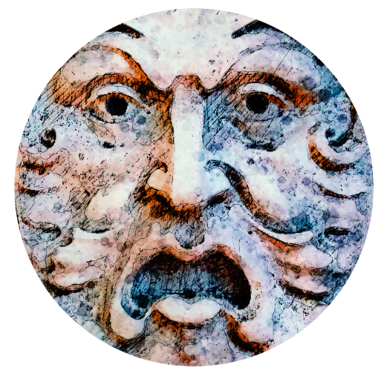
Definition of semantic security: IND-CPA game
Encryption oracle
(same key K of course)
5. Send M₀
4. Send C=ENC(K,M_{b})
5. Send M₁
M₀, M₁
C=ENC(K, M_{b}), b=? P(b)=1/2
Adversary

Slide 27
Definition of semantic security: IND-CPA game
Encryption oracle
(same key K of course)
6. C₀=ENC(K,M₀)
6. C₁=ENC(K,M₁)
M₀, M₁
C=ENC(K, M_{b}), b=? P(b)=1/2
Adversary
C₀ … C₀ C₁ … C₁
Still P(b)=1/2!!!

Slide 28
IND-CPA: Indistinguishability under Chosen Plaintext Attack (semantic security)
Adversary must not be able to compute any information about a plaintext from its ciphertext, even if it has access to an encryption oracle (CPA attack)
Concretely posited as follows:
adversary, given two plaintexts of equal length and given a ciphertext which contains a randomly chosen message among these two, should NOT be able to distinguish which one it is
probability to guess still equal to a coin flip!
IND-CPA consequence 1: encryption MUST be randomized!
A same message must always encrypt to a different ciphertext
And the ciphertext must be undistinguishable from random
IND-CPA consequence 2: if a substring repeats, it must encrypt to a different ciphertext
→ f14dde57651b5cf7 OK
CIAOCIAOCIAOCIAO
→ f14df14df14df14d NO!!

Slide 29

Visual example of semantic security: no info leak!
Substitution Cipher
Semantically secure Cipher

Slide 30
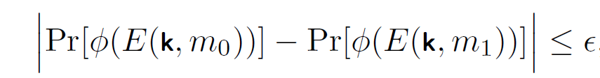
Caveat / 1
Semantic security is a bit more technical:
Introduces the notion of computationally efficient «experiments» φ over the ciphertexts
φ: ciphertext → (0,1)
Does not strictly require ½ probability, but «just» that the difference is negligible
In practice, equality is informally OK, since ε expected to be very small (e.g. order of 2⁻¹⁰⁰)

Slide 31

Caveat / 2
Perfect (unconditional) security: strongest possible security definition
For confidentiality, of course ☺
For any (!) possible «experiment» φ over the ciphertexts
φ: ciphertext → (0,1)
«Any» = also against a computationally unlimited adversary!

